Slide 1
CSET301 – AI-ML
Lecture 7 : Multi-Class Logistic Regression

Slide 2
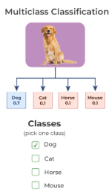





Binary classifiers
Binary Logistic regression classifies target variable in one of the two classes 0 or 1.
Sometimes we have multiple output/target labels – Multi class classification

Slide 3
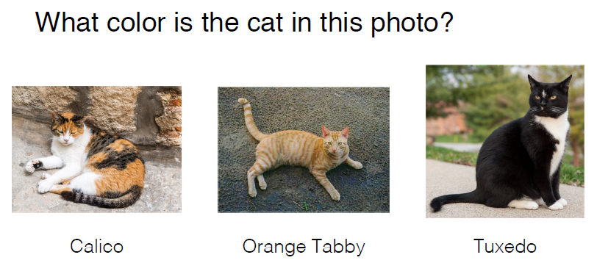
Multi-Class Classification
Multiclass classification refers to the setting when there are > 2 possible class labels.

Slide 4
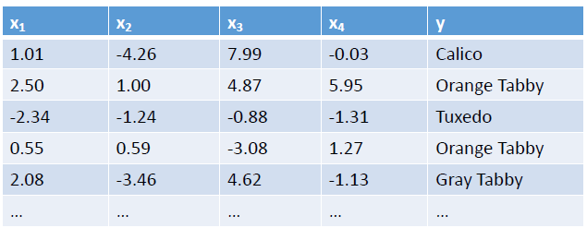

Multi-Class Classification
It’s possible to create multiclass classifiers out of binary classifiers.

Slide 5

Multi-Class Classification
2 strategies used:
One vs All: involves training a binary classifier for each class
One vs One: involves trains a binary classifier for every pair of classes

Slide 6
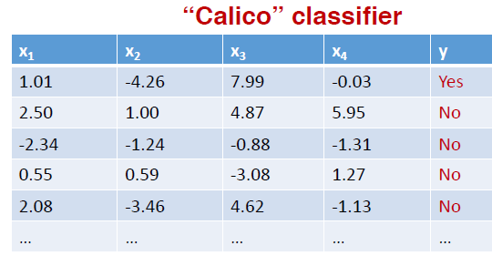
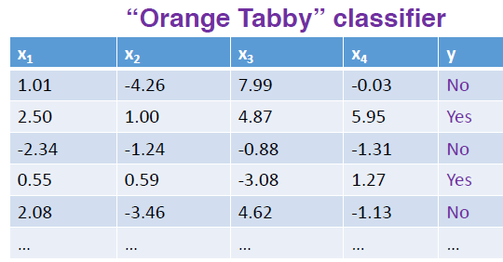

Multi-Class Classification: One vs All
Each classifier predicts whether the instance belongs to the target class or not

Slide 7
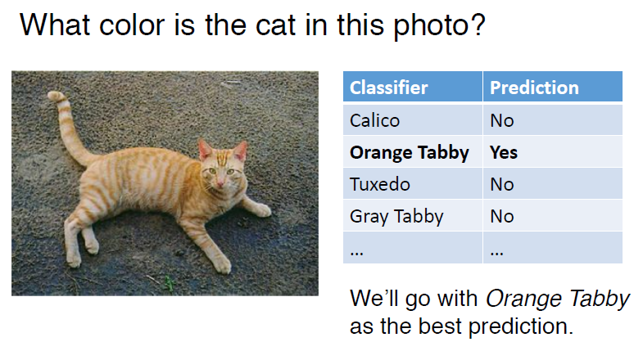

Multi-Class Classification: One vs All

Slide 8
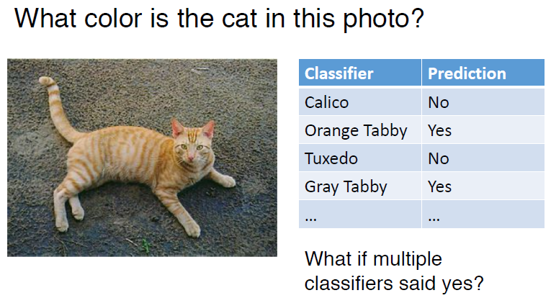

Multi-Class Classification: One vs All

Slide 9

Multi-Class Classification: One vs All

Slide 10
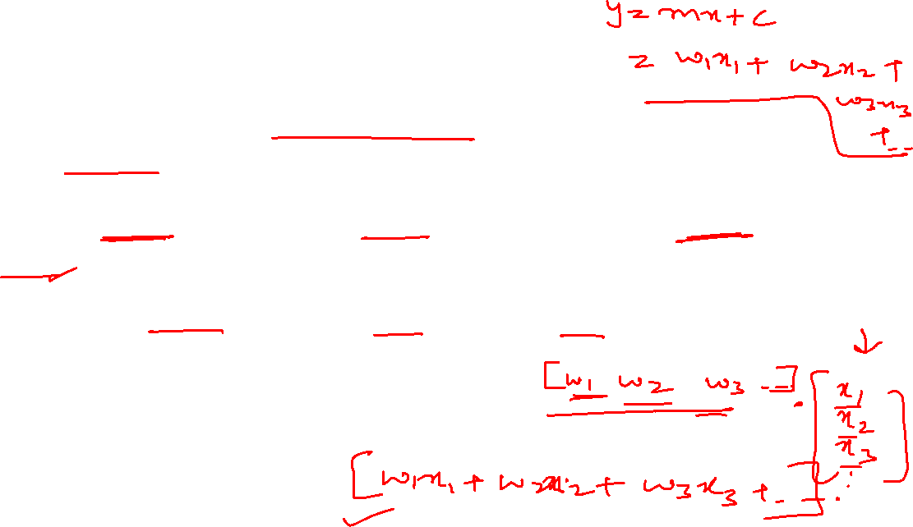
Multi-Class Classification: One vs All
Instead of only using the final binary prediction of each classifier, consider the score associated with the prediction.
Classification score for the linear classifiers can be seen as the dot product w^{T}x_{i}
Go with whichever one-vs-all classifier has the highest score (highest confidence in prediction)

Slide 11
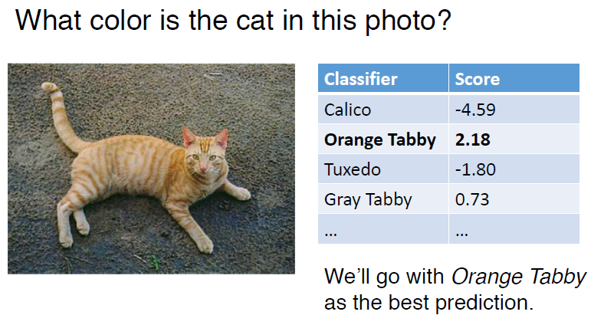

Multi-Class Classification: One vs All

Slide 12

Multi-Class Classification: One vs One / All-Pairs
Train a binary classifier for every pair of classes
Whichever class “wins” more pairwise classifications will be the final prediction

Slide 13
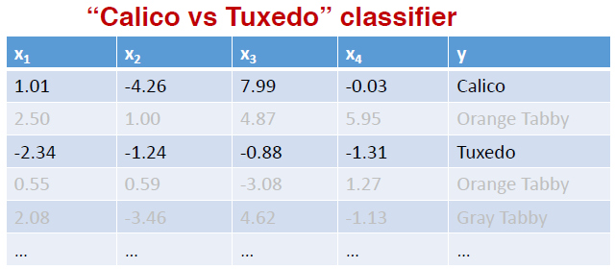
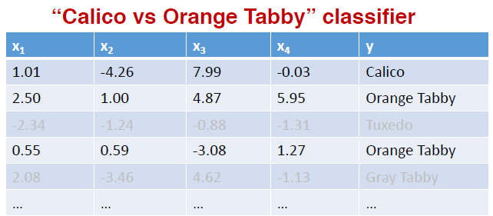
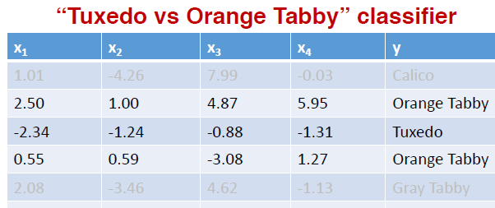

Multi-Class Classification: One vs One

Slide 14
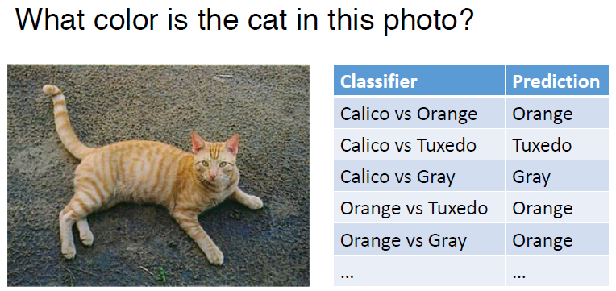

Multi-Class Classification: One vs One

Slide 15
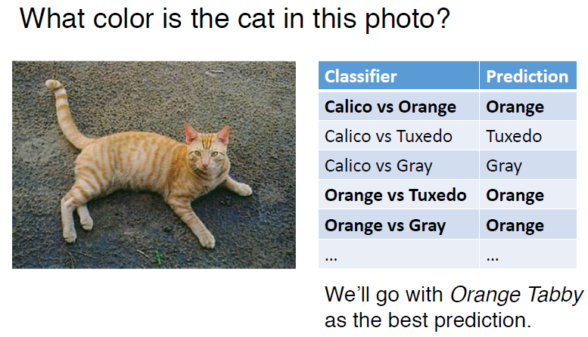

Multi-Class Classification: One vs One

Slide 16

Multi-Class Classification
These approaches can work reasonably well
All pairs is faster to train; one-vs-rest is faster at making predictions
sklearn implements one-vs-all by default when you give more than two classes to a binary classifier

Slide 17
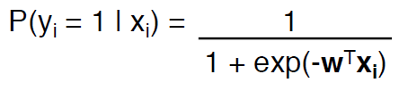
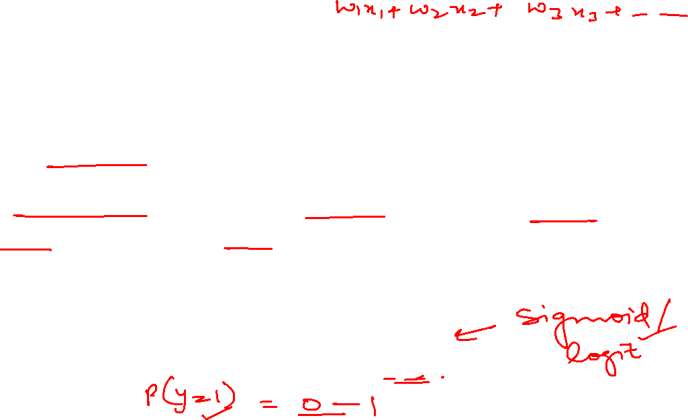
Logistic Regression
Logistic regression can handle multiple classes without having to combine different binary classifiers
Binary logistic regression used the logistic function to give the probability that an instance belonged to the positive class

Slide 18
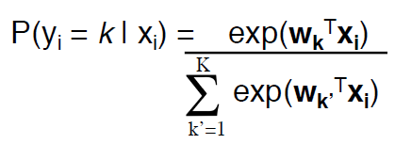

Multinomial Logistic Regression
Multinomial (or multivariate) logistic regression uses a similar but more general function (the softmax function) for the probability of K classes:

Slide 19

Softmax function
Let's say output scores of a image classification task: [2.0, 1.0, 0.1]
Exponentiate: e^2.0 ≈ 7.39, e^1.0 ≈ 2.72, e^0.1 ≈ 1.11
Normalize: 7.39 / (7.39 + 2.72 + 1.11) ≈ 0.657,
      2.72 / (7.39 + 2.72 + 1.11) ≈ 0.243,
      1.11 / (7.39 + 2.72 + 1.11) ≈ 0.100
The output of the softmax function would be [0.657, 0.243, 0.100], representing the probabilities of the image being classified as each of the three classes. The model is most confident that the image is of the first class, with a probability of 65.7%.

Slide 20
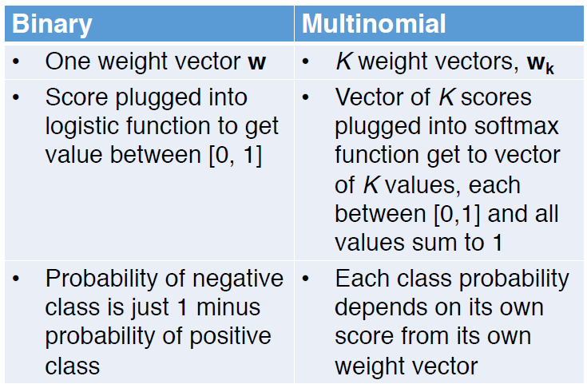
Binary vs Multinomial Logistic regression

Slide 21
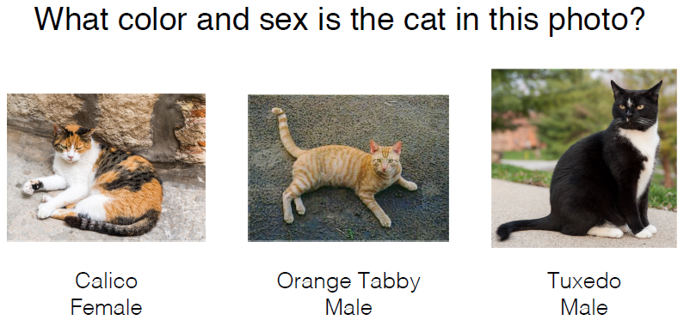
Multi Label Classification

Slide 22
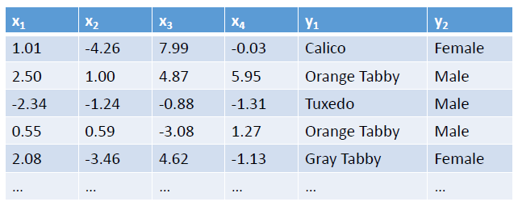
Multi Label Classification
Multi-label classification refers to the setting when there > 1 label you want to predict.

Slide 23
Multi Label Classification
First idea: Train two separate classifiers
One predicts Sex
One predicts color
But, two independent classifiers might output combinations of labels that don’t make sense
Calico cats are almost always female
If your classifiers predict male and calico, this is probably wrong
Also, there might be correlations between the classes that you could help classification if you had a way to combine the two classifiers
Orange cats are more often male (~80% of the time)
If your classifier(s) believed the cat was orange, this would increase the belief that it is male (or vice versa)

Slide 24
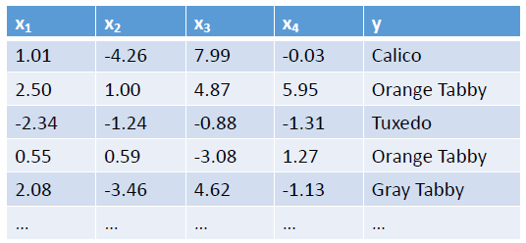
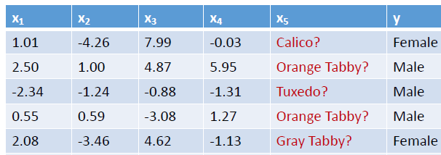
Multi Label Classification
Second idea: Train one classifier first, use its output as a feature in the other.
Example: First train a classifier to predict color:
Then train a classifier to predict sex, using the predicted color as an additional feature.

Slide 25
Multi Label Classification
Second idea: Train one classifier first, use its output as a feature in the other.
Limitations of this approach:
If the first classifier is wrong, you’ll have an incorrect feature value.
This is a “pipeline” approach where one classifier informs the other, rather than both informing each other simultaneously

Slide 26
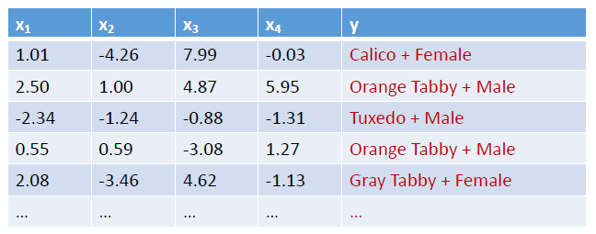
Multi Label Classification
Third idea: Treat combinations of classes as their own “classes”, then do single-label classification

Slide 27
Multi Label Classification
Third idea: Treat combinations of classes as their own “classes”, then do single-label classification
This way you can learn that “Calico + Male” is very unlikely, etc.
Limitations:
All classes are learned independently:
The classifier has no idea that “Tuxedo+Male” and “Tuxedo+Female” are both the same color and therefore probably have similar feature weights

Slide 28
Thank You

